Slide 1
On the Merits of Planning and Planning for Missing Data*
*You’re a fool for not using planned missing data design
Todd D. Little
University of Kansas
Director, Quantitative Training Program
Director, Center for Research Methods and Data Analysis
Director, Undergraduate Social and Behavioral Sciences Methodology Minor
Member, Developmental Psychology Training Program
crmda.KU.edu
Colloquium presented 4-13-2012 @
School of Business, University of Kansas
Special Thanks to: Mijke Rhemtulla & Wei Wu

Slide 2
Road Map
Learn about the different types of missing data
Learn about ways in which the missing data process can be recovered
Understand why imputing missing data is not cheating
Learn why NOT imputing missing data is more likely to lead to errors in generalization!
Learn about intentionally missing designs
Introduce a simple method for significance testing
Discuss imputation with large longitudinal datasets

Slide 3
Key Considerations
Recoverability
Is it possible to recover what the sufficient statistics would have been if there was no missing data?
(sufficient statistics = means, variances, and covariances)
Is it possible to recover what the parameter estimates of a model would have been if there was no missing data.
Bias
Are the sufficient statistics/parameter estimates systematically different than what they would have been had there not been any missing data?
Power
Do we have the same or similar rates of power (1 – Type II error rate) as we would without missing data?

Slide 4
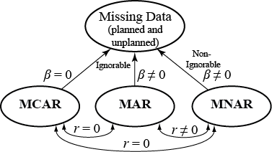
Effects of imputing missing data

Slide 5
Types of Missing Data
Missing Completely at Random (MCAR)
No association with unobserved variables (selective process) and no association with observed variables
Missing at Random (MAR)
No association with unobserved variables, but maybe related to observed variables
Random in the statistical sense of predictable
Non-random (Selective) Missing (MNAR)
Some association with unobserved variables and maybe with observed variables

Slide 6
Effects of imputing missing data
 | No Association with Observed Variable(s) | An Association with Observed Variable(s)
No Association with Unobserved /Unmeasured Variable(s) | MCAR Fully recoverable Fully unbiased | MAR Partly to fully recoverable Less biased to unbiased
An Association with Unobserved /Unmeasured Variable(s) | NMAR Unrecoverable Biased (same bias as not estimating) | MAR/NMAR Partly recoverable Same to unbiased

Slide 7
Effects of imputing missing data
 | No Association with ANY Observed Variable | An Association with Analyzed Variables | An Association with Unanalyzed Variables
No Association with Unobserved /Unmeasured Variable(s) | MCAR Fully recoverable Fully unbiased | MAR Partly to fully recoverable Less biased to unbiased | MAR Partly to fully recoverable Less biased to unbiased
An Association with Unobserved /Unmeasured Variable(s) | NMAR Unrecoverable Biased (same bias as not estimating) | MAR/NMAR Partly to fully recoverable Same to unbiased | MAR/NMAR Partly to fully recoverable Same to unbiased
Statistical Power: Will always be greater when missing data is imputed!

Slide 8
Modern Missing Data Analysis
MI or FIML
In 1978, Rubin proposed Multiple Imputation (MI)
An approach especially well suited for use with large public-use databases.
First suggested in 1978 and developed more fully in 1987.
MI primarily uses the Expectation Maximization (EM) algorithm and/or the Markov Chain Monte Carlo (MCMC) algorithm.
Beginning in the 1980’s, likelihood approaches developed.
Multiple group SEM
Full Information Maximum Likelihood (FIML).
An approach well suited to more circumscribed models

Slide 9
Full Information Maximum Likelihood
FIML maximizes the case-wise -2loglikelihood of the available data to compute an individual mean vector and covariance matrix for every observation.
Since each observation’s mean vector and covariance matrix is based on its own unique response pattern, there is no need to fill in the missing data.
Each individual likelihood function is then summed to create a combined likelihood function for the whole data frame.
Individual likelihood functions with greater amounts of missing are given less weight in the final combined likelihood function than those will a more complete response pattern, thus controlling for the loss of information.
Formally, the function that FIML is maximizing is
where

Slide 10
Multiple Imputation
Multiple imputation involves generating m imputed datasets (usually between 20 and 100), running the analysis model on each of these datasets, and combining the m sets of results to make inferences.
By filling in m separate estimates for each missing value we can account for the uncertainty in that datum’s true population value.
Data sets can be generated in a number of ways, but the two most common approaches are through an MCMC simulation technique such as Tanner & Wong’s (1987) Data Augmentation algorithm or through bootstrapping likelihood estimates, such as the bootstrapped EM algorithm used by Amelia II.
SAS uses data augmentation to pull random draws from a specified posterior distribution (i.e., stationary distribution of EM estimates).
After m data sets have been created and the analysis model has been run on each separately, the resulting estimates are commonly combined with Rubin’s Rules (Rubin, 1987).

Slide 11
Fraction Missing
Fraction Missing is a measure of efficiency lost due to missing data. It is the extent to which parameter estimates have greater standard errors than they would have had, had all the data been observed.
It is a ratio of variances:
Estimated parameter variance in the complete data set
Between-imputation variance
 | estimated parameter variance in the complete data set
 | total parameter variance taking into account missingness
Notes:
Estimated parameter variance in the complete data set = within-imputation variance = squared average parameter standard error estimate (averaged across m imputations)
Total parameter variance taking into account missingness = between-imputation variance + within-imputation variances
These formulae are asymptotically correct (i.e., as m → infinity). With fewer imputations, small-sample corrections exist. E.g., see Schafer, 1997, or Bodner, 2008.

Slide 12
Fraction Missing
Fraction of Missing Information (asymptotic formula)
Varies by parameter in the model
Is typically smaller for MCAR than MAR data
Notes:
Estimated parameter variance in the complete data set = within-imputation variance = squared average parameter standard error estimate (averaged across m imputations)
Total parameter variance taking into account missingness = between-imputation variance + within-imputation variances
These formulae are asymptotically correct (i.e., as m → infinity). With fewer imputations, small-sample corrections exist. E.g., see Schafer, 1997, or Bodner, 2008.

Slide 13
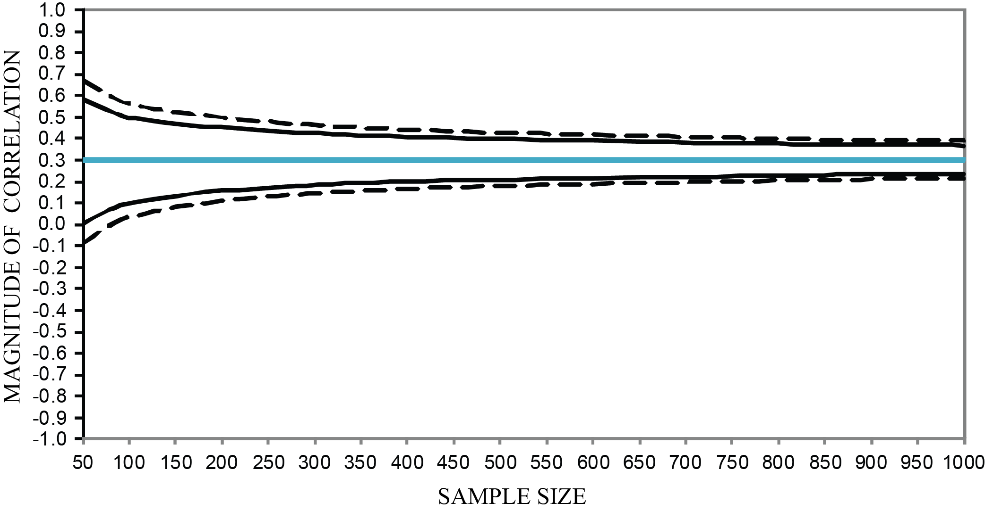
60% MAR correlation estimates with 1 PCA auxiliary variable (r = .60)
Figure 7. Simulation results showing XY correlation estimates (with 95 and 99% confidence intervals) associated with a 60% MAR Situation and 1 PCA auxiliary variable.
crmda.KU.edu
13

Slide 14
Three-form design
What goes in the Common Set?
Form | Common Set X | Variable Set A | Variable Set B | Variable Set C
1 | ¼ of items | ¼ of items | ¼ of items | missing
2 | ¼ of items | ¼ of items | missing | ¼ of items
3 | ¼ of items | missing | ¼ of items | ¼ of items
Notes:
What goes in the common set?
- Items of central importance (e.g., the main dependent variable you want to assess)
- Items related to hypotheses that may otherwise lack power (e.g., if you suspect a subtle effect of something)
- Auxiliary variables, to reduce the effects of unplanned missingness, i.e., turn MNAR data into MAR data.

Slide 15
Three-form design: Example
21 questions made up of 7 3-question subtests
Subtest | Item
Demographics | How old are you? Are you male or female? What is your occupation?
Musical Taste | What is your favorite genre of music? Do you like to listen to music while you work? Do you prefer music played loud or softly?
Openness | I have a rich vocabulary. I have excellent ideas. I have a vivid imagination.
Subtest | Item
Extraversion | I start conversations. I am the life of the party. I am comfortable around people.
Neuroticism | I get stressed out easily. I get irritated easily. I have frequent mood swings.
Conscientiousness | I am always prepared. I like order. I pay attention to details.
Agreeableness | I am interested in people. I have a soft heart. I take time out for others.
Notes:
First we choose which items we want in the common set. We’ll put all the demographic items in there, because these might help us to recover the other items better later.

Slide 16
Three-form design: Example
Common Set (X)
Subtest | Item
Demographics | How old are you? Are you male or female? What is your occupation?
Musical Taste | What is your favorite genre of music? Do you like to listen to music while you work? Do you prefer music played loud or softly?
Openness | I have a rich vocabulary. I have excellent ideas. I have a vivid imagination.
Subtest | Item
Extraversion | I start conversations. I am the life of the party. I am comfortable around people.
Neuroticism | I get stressed out easily. I get irritated easily. I have frequent mood swings.
Conscientiousness | I am always prepared. I like order. I pay attention to details.
Agreeableness | I am interested in people. I have a soft heart. I take time out for others.
Notes:
First we choose which items we want in the common set. We’ll put all the demographic items in there, because these might help us to recover the other items better later.

Slide 17
Three-form design: Example
Common Set (X)
Subtest | Item
Demographics | How old are you? Are you male or female? What is your occupation?
Musical Taste | What is your favorite genre of music? Do you like to listen to music while you work? Do you prefer music played loud or softly?
Openness | I have a rich vocabulary. I have excellent ideas. I have a vivid imagination.
Subtest | Item
Extraversion | I start conversations. I am the life of the party. I am comfortable around people.
Neuroticism | I get stressed out easily. I get irritated easily. I have frequent mood swings.
Conscientiousness | I am always prepared. I like order. I pay attention to details.
Agreeableness | I am interested in people. I have a soft heart. I take time out for others.
Notes:
Second we’ll put all of the musical taste items in the common set, because there are the question we’re really interested in. Our key variables are most important to us, so we don’t want to introduce missingness there if we don’t have to.

Slide 18
Three-form design: Example
Set A
Subtest | Item
Demographics | How old are you? Are you male or female? What is your occupation?
Musical Taste | What is your favorite genre of music? Do you like to listen to music while you work? Do you prefer music played loud or softly?
Openness | I have a rich vocabulary. I have excellent ideas. I have a vivid imagination.
Subtest | Item
Extraversion | I start conversations. I am the life of the party. I am comfortable around people.
Neuroticism | I get stressed out easily. I get irritated easily. I have frequent mood swings.
Conscientiousness | I am always prepared. I like order. I pay attention to details.
Agreeableness | I am interested in people. I have a soft heart. I take time out for others.
I start conversations.
I get stressed out easily.
I am always prepared.
I have a rich vocabulary.
I am interested in people.
Notes:
Second we’ll put all of the musical taste items in the common set, because there are the question we’re really interested in. Our key variables are most important to us, so we don’t want to introduce missingness there if we don’t have to.

Slide 19
Three-form design: Example
Set B
Subtest | Item
Demographics | How old are you? Are you male or female? What is your occupation?
Musical Taste | What is your favorite genre of music? Do you like to listen to music while you work? Do you prefer music played loud or softly?
Openness | I have a rich vocabulary. I have excellent ideas. I have a vivid imagination.
Subtest | Item
Extraversion | I start conversations. I am the life of the party. I am comfortable around people.
Neuroticism | I get stressed out easily. I get irritated easily. I have frequent mood swings.
Conscientiousness | I am always prepared. I like order. I pay attention to details.
Agreeableness | I am interested in people. I have a soft heart. I take time out for others.
I am the life of the party.
I get irritated easily.
I like order.
I have excellent ideas.
I have a soft heart.
crmda.KU.edu
Notes:
Second we’ll put all of the musical taste items in the common set, because there are the question we’re really interested in. Our key variables are most important to us, so we don’t want to introduce missingness there if we don’t have to.

Slide 20
Three-form design: Example
Set C
Subtest | Item
Demographics | How old are you? Are you male or female? What is your occupation?
Musical Taste | What is your favorite genre of music? Do you like to listen to music while you work? Do you prefer music played loud or softly?
Openness | I have a rich vocabulary. I have excellent ideas. I have a vivid imagination.
Subtest | Item
Extraversion | I start conversations. I am the life of the party. I am comfortable around people.
Neuroticism | I get stressed out easily. I get irritated easily. I have frequent mood swings.
Conscientiousness | I am always prepared. I like order. I pay attention to details.
Agreeableness | I am interested in people. I have a soft heart. I take time out for others.
I am comfortable around people.
I have frequent mood swings.
I pay attention to details.
I have a vivid imagination.
I take time out for others.
Notes:
Second we’ll put all of the musical taste items in the common set, because there are the question we’re really interested in. Our key variables are most important to us, so we don’t want to introduce missingness there if we don’t have to.

Slide 21
Form 1 (XAB) | Form 2 (XAC) | Form 3 (XBC)
How old are you? Are you male or female? What is your occupation? | How old are you? Are you male or female? What is your occupation? | How old are you? Are you male or female? What is your occupation?
What is your favorite genre of music? Do you like to listen to music while you work? Do you prefer music played loud or softly? | What is your favorite genre of music? Do you like to listen to music while you work? Do you prefer music played loud or softly? | What is your favorite genre of music? Do you like to listen to music while you work? Do you prefer music played loud or softly?
I have a rich vocabulary. I have excellent ideas. | I have a rich vocabulary. I have a vivid imagination. | I have excellent ideas. I have a vivid imagination.
I start conversations. I am the life of the party. | I start conversations. I am comfortable around people. | I am the life of the party. I am comfortable around people.
I get stressed out easily. I get irritated easily. | I get stressed out easily. I have frequent mood swings. | I get irritated easily. I have frequent mood swings.
I am always prepared. I like order. | I am always prepared. I pay attention to details. | I like order. I pay attention to details.
I am interested in people. I have a soft heart. | I am interested in people. I take time out for others. | I have a soft heart. I take time out for others.
Notes:
Now the 21-item questionnaire is shortened to 16 items. Every participant gets 2/3 items for each personality trait.

Slide 22
Participant | Form | Age | Sex | Occupation | Genre | Work Music | Volume | Open1 | Open2 | Open3 | Extra1 | Extra2 | Extra3 | Neuro1 | Neuro2 | Neuro3 | Consc1 | Consc2 | Consc3 | Agree1 | Agree2 | Agree3
1 | 1 | 47 | F | professor | Classical | N | loud | 4 | 4 | -- | 1 | 5 | -- | 1 | 2 | -- | 4 | 2 | -- | 3 | 2 | --
2 | 1 | 42 | F | musician | Funk | N | soft | 1 | 3 | -- | 2 | 2 | -- | 5 | 3 | -- | 4 | 1 | -- | 2 | 1 | --
3 | 1 | 27 | M | student | Jazz | N | soft | 2 | 4 | -- | 5 | 5 | -- | 2 | 4 | -- | 5 | 1 | -- | 4 | 2 | --
4 | 1 | 29 | M | server | Metal | N | soft | 1 | 3 | -- | 5 | 2 | -- | 2 | 1 | -- | 1 | 1 | -- | 4 | 2 | --
5 | 1 | 27 | M | chef | Rock | N | soft | 1 | 4 | -- | 5 | 1 | -- | 2 | 2 | -- | 5 | 3 | -- | 2 | 2 | --
6 | 2 | 21 | F | painter | Pop | Y | loud | 4 | -- | 4 | 2 | -- | 1 | 1 | -- | 5 | 1 | -- | 5 | 5 | -- | 3
7 | 2 | 39 | F | librarian | Alt | N | loud | 1 | -- | 4 | 4 | -- | 3 | 4 | -- | 3 | 4 | -- | 2 | 4 | -- | 3
8 | 2 | 22 | F | server | Ska | N | soft | 4 | -- | 2 | 3 | -- | 3 | 3 | -- | 3 | 1 | -- | 2 | 5 | -- | 5
9 | 2 | 38 | M | doctor | Punk | N | loud | 1 | -- | 3 | 2 | -- | 2 | 2 | -- | 4 | 4 | -- | 1 | 3 | -- | 2
10 | 2 | 29 | F | statistician | Pop | N | loud | 4 | -- | 5 | 3 | -- | 4 | 5 | -- | 4 | 3 | -- | 2 | 3 | -- | 1
11 | 3 | 28 | F | chef | Rock | Y | loud | -- | 3 | 3 | -- | 5 | 5 | -- | 5 | 4 | -- | 3 | 3 | -- | 2 | 5
12 | 3 | 25 | M | nurse | Rock | N | soft | -- | 4 | 5 | -- | 2 | 2 | -- | 2 | 5 | -- | 4 | 5 | -- | 3 | 5
13 | 3 | 29 | M | lawyer | Jazz | Y | soft | -- | 3 | 4 | -- | 3 | 2 | -- | 4 | 5 | -- | 4 | 5 | -- | 1 | 2
14 | 3 | 38 | F | accountant | Metal | N | soft | -- | 3 | 1 | -- | 1 | 2 | -- | 3 | 3 | -- | 4 | 4 | -- | 5 | 4
15 | 3 | 21 | F | secretary | Alt | N | loud | -- | 4 | 4 | -- | 1 | 2 | -- | 1 | 1 | -- | 5 | 3 | -- | 4 | 5

Slide 23
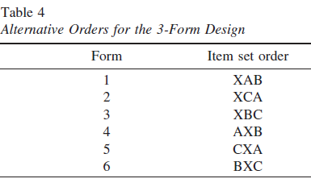
Expansions of 3-Form Design
(Graham, Taylor, Olchowski, & Cumsille, 2006)
Notes:
3 forms can be expanded to 10 (or any number of) forms, and you can have more than one set missing for any group. You can also move around the order of item sets if you’re worried about order effects. In short, you can do pretty much anything with this, as long as participants are randomly assigned to forms, and as long as there is a sufficient amount of overlap between people who get each item set (e.g., if all the people who get item set B do not get item set C and vice versa, then there will be no way to estimate the correlations between the items in B and C.

Slide 24
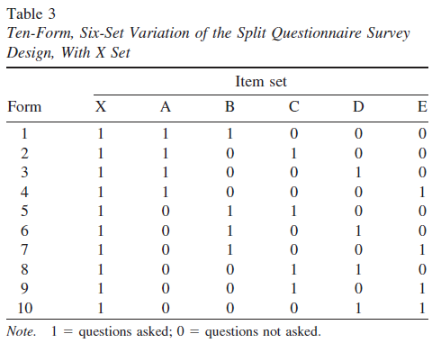
Expansions of 3-Form Design
(Graham, Taylor, Olchowski, & Cumsille, 2006)
Notes:
3 forms can be expanded to 10 (or any number of) forms, and you can have more than one set missing for any group. You can also move around the order of item sets if you’re worried about order effects. In short, you can do pretty much anything with this, as long as participants are randomly assigned to forms, and as long as there is a sufficient amount of overlap between people who get each item set (e.g., if all the people who get item set B do not get item set C and vice versa, then there will be no way to estimate the correlations between the items in B and C.

Slide 25
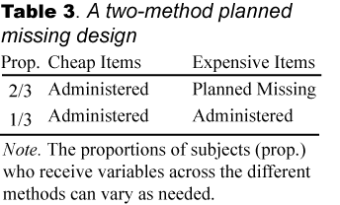
2-Method Planned Missing Design

Slide 26
2-Method Planned Missing Design
Use when you have an ideal (highly valid) measure that is time-consuming or expensive
By supplementing this measure with a less expensive or time-consuming measure, it is possible to increase total sample size and get higher power
e.g., measuring stress
Expensive measure = collect spit samples, measure cortisol
Inexpensive measure = survey querying stressful thoughts
e.g., measuring intelligence
Expensive measure = WAIS IQ scale
Inexpensive measure = multiple choice IQ test
e.g., measuring smoking
Expensive measure = carbon monoxide measure
Inexpensive measure = self-report

Slide 27
2-Method Planned Missing Design
Assumptions:
expensive measure is unbiased (i.e., valid)
inexpensive measure is systematically biased
Using both measures (on a subset of participants) enables us to estimate and remove the bias from the inexpensive measure (for all participants)
As the inexpensive measure gets more valid, fewer observations are needed on the expensive measure
If inexpensive measure is perfectly unbiased, we don’t need the expensive measure at all!

Slide 28
2-Method Planned Missing Design
Self-Report
Bias
Self-
Report 1
Self-
Report 2
CO
Cotinine
Smoking
Notes:
The analysis of this design is based on a latent variable model, where the construct that you’re interested in , in this case Smoking, is indicated by both the inexpensive and the expensive measures. The inexpensive measures are then allowed to correlate to remove the self-report bias. Having the expensive measures in the model allows us to model the self-report bias, which makes our model better and our findings more generalizable. Having the cheap measures allows us to include more participants than we could otherwise do, allowing for more power.

Slide 29
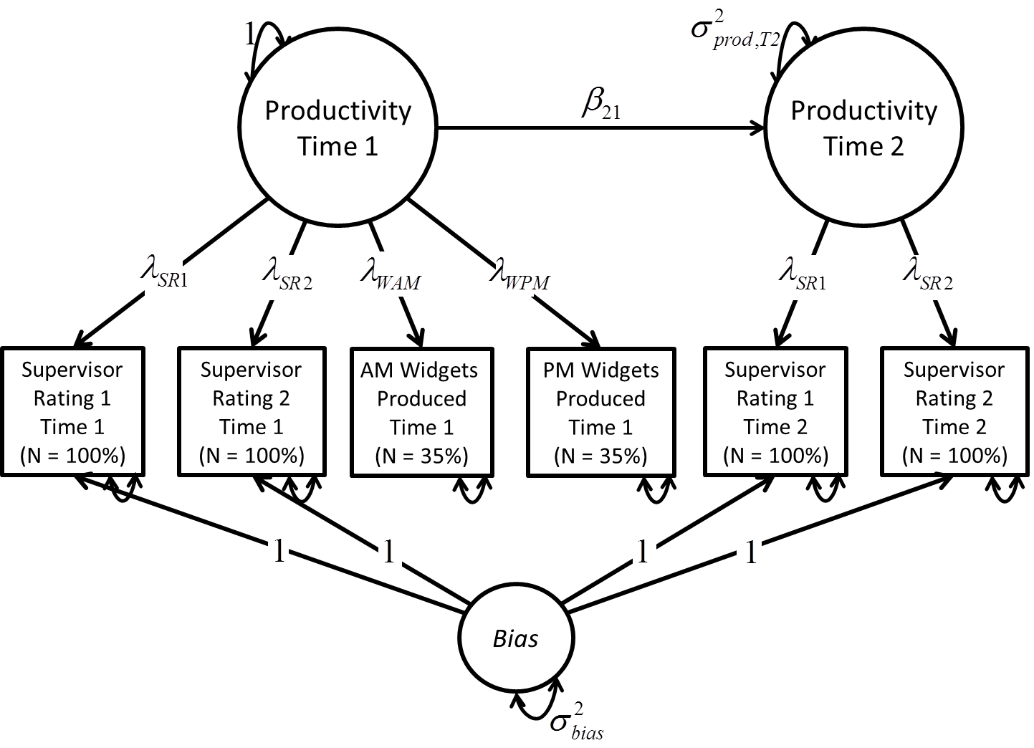
2-Method Planned Missing Design
Notes:
The analysis of this design is based on a latent variable model, where the construct that you’re interested in , in this case Smoking, is indicated by both the inexpensive and the expensive measures. The inexpensive measures are then allowed to correlate to remove the self-report bias. Having the expensive measures in the model allows us to model the self-report bias, which makes our model better and our findings more generalizable. Having the cheap measures allows us to include more participants than we could otherwise do, allowing for more power.

Slide 30
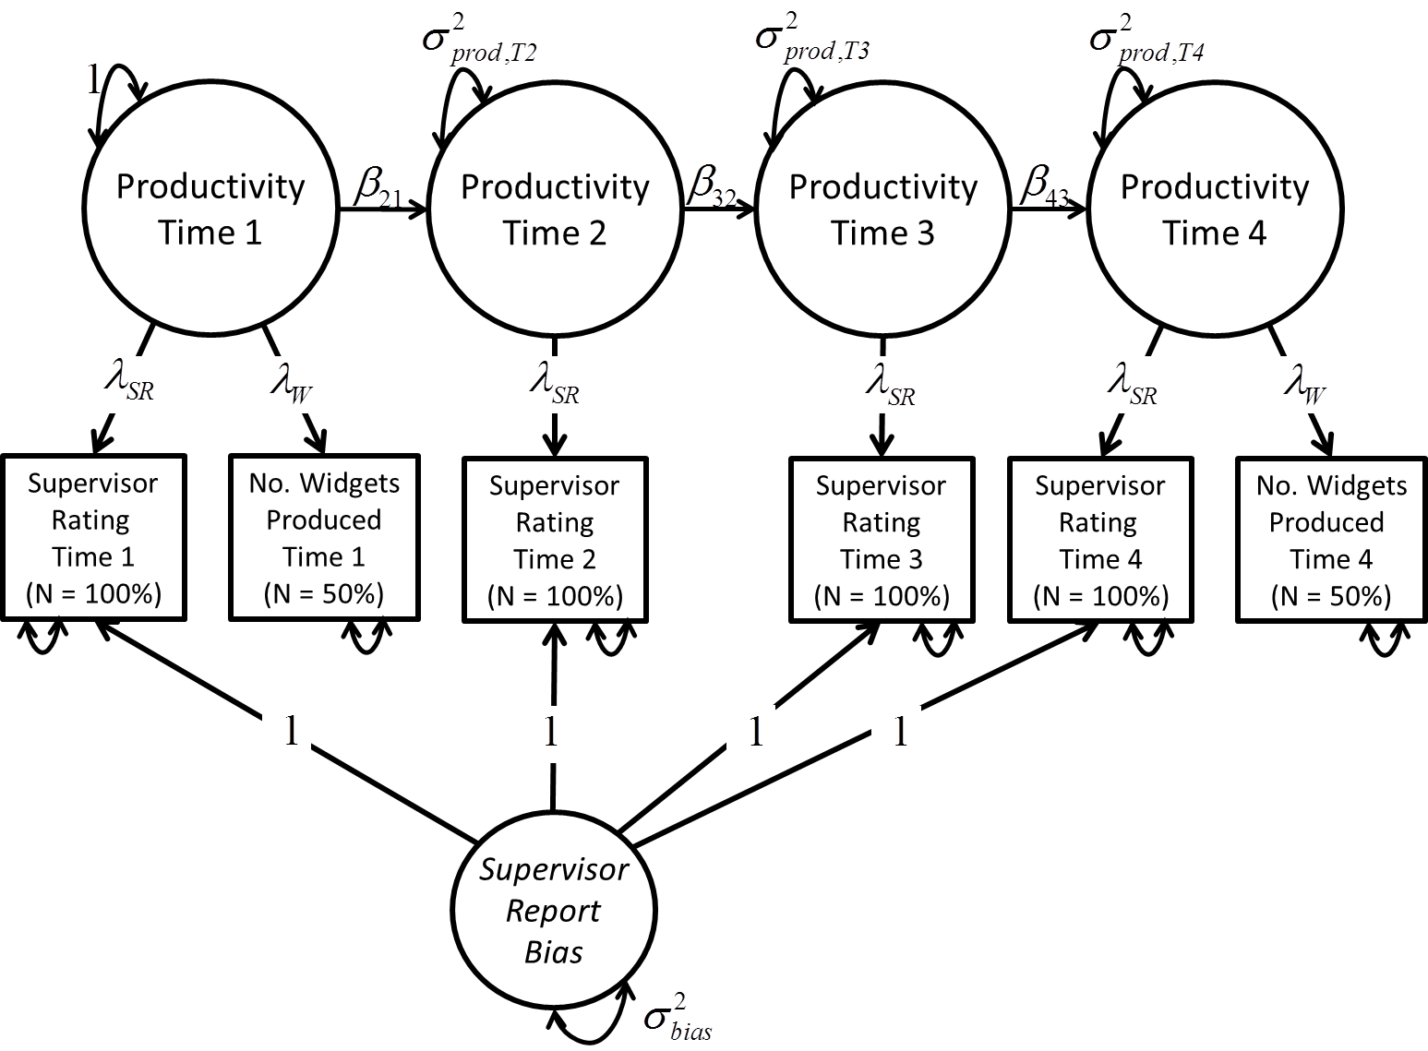
2-Method Planned Missing Design
Notes:
The analysis of this design is based on a latent variable model, where the construct that you’re interested in , in this case Smoking, is indicated by both the inexpensive and the expensive measures. The inexpensive measures are then allowed to correlate to remove the self-report bias. Having the expensive measures in the model allows us to model the self-report bias, which makes our model better and our findings more generalizable. Having the cheap measures allows us to include more participants than we could otherwise do, allowing for more power.

Slide 31
age
grade
4;6-
4;11
5;0-
5;5
5;6-
5;11
6;0-
6;5
6;6-
6;11
7;0-
7;5
7;6-
7;11
student
K
1
2
1
5;6
6;7
7;3
2
5;3
6;0
7;4
3
4;9
5;11
6;10
4
4;6
5;5
6;4
5
4;11
5;9
6;10
6
5;7
6;7
7;5
7
5;2
6;1
7;3
8
5;4
6;5
7;6

Slide 32
age
Out of 3 waves, we create 7 waves of data with high missingness
Allows for more fine-tuned age-specific growth modeling
Even high amounts of missing data are not typically a problem for estimation
4;6-
4;11
5;0-
5;5
5;6-
5;11
6;0-
6;5
6;6-
6;11
7;0-
7;5
7;6-
7;11
5;6
6;7
7;3
5;3
6;0
7;4
4;9
5;11
6;10
4;6
5;5
6;4
4;11
5;9
6;10
5;7
6;7
7;5
5;2
6;1
7;3
5;4
6;5
7;6

Slide 33
Growth-Curve Design
Group | Time 1 | Time 2 | Time 3 | Time 4 | Time 5
1 | x | x | x | x | x
2 | x | x | x | x | missing
3 | x | x | x | missing | x
4 | x | x | missing | x | x
5 | x | missing | x | x | x
6 | missing | x | x | x | x
Notes:
Here’s an example of a longitudinal planned missing design, from Graham, Taylor, & Cumsille (2001). Here, one group of participants is measured at 5 measurement occasions, and each of 5 other groups are missing one occasion each. For example, suppose you are interested in measuring math ability on 5 consecutive weeks of an intensive math-training program. Instead of testing all participants at all weeks, you could employ a planned missing design like this one to selectively omit one group of students at each interval.
One benefit of this design, like the 3-form design, is that it requires measuring people fewer times, making the study a little cheaper and easier to complete. A more important benefit, unique to longitudinal planned-missing designs, is that practice effects may be reduced. Having fewer time points allows each participant a little less practice, thus resulting in less slightly less biased results near the end of the study. Even more importantly, this design allows the researcher to estimate practice effects. By comparing group 6 with groups 1-4 on their performance at Time 2, group 6 would be expected to do worse than groups 1-4 to the extent that the other groups were helped by having been tested on a prior occasion. Similarly, at Time 3, groups 5 and 6 would have less practice than groups 1-3. In this way, the effect of having a prior testing occasion, or multiple testing occasions can be estimated and accounted for.
[Graham et al. note that the advantage of having one group measured at every time point is that it makes it easier to estimate “higher-order partial correlations” – I don’t know what they mean by this but perhaps it makes sense to you.]

Slide 34
Growth Curve Design II
Group | Time 1 | Time 2 | Time 3 | Time 4 | Time 5
1 | x | x | x | x | x
2 | x | x | x | missing | missing
3 | x | x | missing | x | missing
4 | x | missing | x | x | missing
5 | missing | x | x | x | missing
6 | x | x | missing | missing | x
7 | x | missing | x | missing | x
8 | missing | x | x | missing | x
9 | x | missing | missing | x | x
10 | missing | x | missing | x | x
11 | missing | missing | x | x | x
Notes:
Here is another more elaborate version of the previous design. Here we have all combinations of two missing time points. This design allows the researcher to collect even fewer data but still have sufficient power to estimate trends across time.
Frequently, we are interested in estimating a linear trend over time. When this is the case, it may be helpful to have more data at the first and last testing occasions than during the middle, to more accurately estimate the slope of the linear trend. In this case, the researcher can choose to weight more heavily those groups where the first and last time points are not missing by having relatively few participants in those groups. You could even go so far as removing those groups entirely, leaving only missing data at the middle time points.

Slide 35
Growth Curve Design II
Group | Time 1 | Time 2 | Time 3 | Time 4 | Time 5
1 | x | x | x | x | x
2 | x | x | x | missing | missing
3 | x | x | missing | x | missing
4 | x | missing | x | x | missing
5 | missing | x | x | x | missing
6 | x | x | missing | missing | x
7 | x | missing | x | missing | x
8 | missing | x | x | missing | x
9 | x | missing | missing | x | x
10 | missing | x | missing | x | x
11 | missing | missing | x | x | x
Notes:
If you get rid of these 7 groups, you’re left with all combinations of 2 of the middle 3 timepoints missing, as well as one group with complete data on all five time points. This design allows quite accurate estimation of a linear slope, but it would not allow great estimation of, say, a quadratic slope where the middle part of the time window would have to be very accurately estimated.

Slide 36
On the Merits of Planning and Planning for Missing Data*
*You’re a fool for not using planned missing data design
Thanks for your attention!
Questions?
crmda.KU.edu
Colloquium presented 4-13-2012 @
School of Business, University of Kansas

